Slide 1
Data Mining
Classification: Basic Concepts, Decision Trees, and Model Evaluation
Lecture Notes for Chapter 4
Introduction to Data Mining
by
Tan, Steinbach, Kumar
© Tan,Steinbach, Kumar Introduction to Data Mining 4/18/2004 <number>

Slide 2
Classification: Definition
Given a collection of records (training set )
  Each record contains a set of attributes, one of the attributes is the class.
Find a model for class attribute as a function of the values of other attributes.
Goal: previously unseen records should be assigned a class as accurately as possible.
  A test set is used to determine the accuracy of the model. Usually, the given data set is divided into training and test sets, with training set used to build the model and test set used to validate it.

Slide 3

Illustrating Classification Task

Slide 4




Examples of Classification Task
Predicting tumor cells as benign or malignant
Classifying credit card transactions
as legitimate or fraudulent
Classifying secondary structures of protein
as alpha-helix, beta-sheet, or random
coil
Categorizing news stories as finance,
weather, entertainment, sports, etc

Slide 5
Classification Techniques
Decision Tree based Methods
Rule-based Methods
Memory based reasoning
Neural Networks
Naïve Bayes and Bayesian Belief Networks
Support Vector Machines

Slide 6

Example of a Decision Tree
categorical
categorical
continuous
class
Splitting Attributes
Refund
Yes
No
NO
MarSt
Single, Divorced
Married
TaxInc
NO
< 80K
> 80K
NO
YES
Training Data
Model: Decision Tree

Slide 7
Another Example of Decision Tree
categorical
categorical
continuous
class
MarSt
Single, Divorced
Married
NO
Refund
Yes
No
NO
TaxInc
< 80K
> 80K
NO
YES
There could be more than one tree that fits the same data!

Slide 8

Decision Tree Classification Task
Decision Tree

Slide 9

Apply Model to Test Data
Test Data
Start from the root of tree.
Refund
Yes
No
NO
MarSt
Single, Divorced
Married
TaxInc
NO
< 80K
> 80K
NO
YES

Slide 10
Apply Model to Test Data
Test Data
Refund
Yes
No
NO
MarSt
Single, Divorced
Married
TaxInc
NO
< 80K
> 80K
NO
YES

Slide 11

Apply Model to Test Data
Test Data
Refund
Yes
No
NO
MarSt
Single, Divorced
Married
TaxInc
NO
< 80K
> 80K
NO
YES

Slide 12
Apply Model to Test Data
Test Data
Refund
Yes
No
NO
MarSt
Single, Divorced
Married
TaxInc
NO
< 80K
> 80K
NO
YES

Slide 13

Apply Model to Test Data
Test Data
Refund
Yes
No
NO
MarSt
Single, Divorced
Married
TaxInc
NO
< 80K
> 80K
NO
YES

Slide 14
Apply Model to Test Data
Test Data
Refund
Yes
No
NO
MarSt
Single, Divorced
Married
Assign Cheat to “No”
TaxInc
NO
< 80K
> 80K
NO
YES

Slide 15

Decision Tree Classification Task
Decision Tree

Slide 16
Decision Tree Induction
Many Algorithms:
  Hunt’s Algorithm (one of the earliest)
  CART
  ID3, C4.5
  SLIQ,SPRINT

Slide 17

General Structure of Hunt’s Algorithm
Let D_{t} be the set of training records that reach a node t
General Procedure:
  If D_{t} contains records that belong the same class y_{t}, then t is a leaf node labeled as y_{t}
  If D_{t} is an empty set, then t is a leaf node labeled by the default class, y_{d}
  If D_{t} contains records that belong to more than one class, use an attribute test to split the data into smaller subsets. Recursively apply the procedure to each subset.
D_{t}
?

Slide 18

Hunt’s Algorithm
Refund
Don’t
Cheat
Yes
No
Don’t
Cheat
Don’t
Cheat
Refund
Refund
Yes
No
Yes
No
Don’t
Cheat
Marital
Status
Don’t
Cheat
Marital
Status
Single,
Divorced
Single,
Divorced
Married
Married
Cheat
Don’t
Cheat
Taxable
Income
Don’t
Cheat
< 80K
>= 80K
Don’t
Cheat
Cheat

Slide 19
Tree Induction
Issues
  Determine how to split the records
    How to specify the attribute test condition?
    How to determine the best split?
  Determine when to stop splitting

Slide 20
How to Specify Test Condition?
Depends on attribute types
  Nominal
  Ordinal
  Continuous
Depends on number of ways to split
  2-way split
  Multi-way split

Slide 21
Tree Induction
Issues
  Determine how to split the records
    How to specify the attribute test condition?
    How to determine the best split?
  Determine when to stop splitting

Slide 22

How to determine the Best Split
Before Splitting: 10 records of class 0,
10 records of class 1
Which test condition is the best?
Reduce impurity!

Slide 23





How to Find the Best Split
Before Splitting:
M0
A?
B?
Yes
No
Yes
No
Node N1
Node N2
Node N3
Node N4
M1
M2
M3
M4
M12
M34
Gain = M0 – M12 vs M0 – M34

Slide 24
Measures of Node Impurity
Gini Index
Entropy
Misclassification error

Slide 25

Splitting Criteria based on INFO
Entropy at a given node t:
    (NOTE: p( j | t) is the relative frequency of class j at node t).
  Measures homogeneity of a node.
    Maximum (log n_{c}) when records are equally distributed among all classes implying least information
    Minimum (0.0) when all records belong to one class, implying most information
  Entropy based computations are similar to the GINI index computations

Slide 26




Examples for computing Entropy
P(C1) = 0/6 = 0 P(C2) = 6/6 = 1
Entropy = – 0 log 0 – 1 log 1 = – 0 – 0 = 0
P(C1) = 1/6 P(C2) = 5/6
Entropy = – (1/6) log₂ (1/6) – (5/6) log₂ (1/6) = 0.65
P(C1) = 2/6 P(C2) = 4/6
Entropy = – (2/6) log₂ (2/6) – (4/6) log₂ (4/6) = 0.92

Slide 27

Splitting Based on INFO...
Information Gain:
    Parent Node, p is split into k partitions;
    n_{i} is number of records in partition i
  Measures Reduction in Entropy achieved because of the split. Choose the split that achieves most reduction (maximizes GAIN)
  Used in ID3 and C4.5
  Disadvantage: Tends to prefer splits that result in large number of partitions, each being small but pure.

Slide 28


Splitting Based on INFO...
Gain Ratio:
    Parent Node, p is split into k partitions
    n_{i} is the number of records in partition i
  Adjusts Information Gain by the entropy of the partitioning (SplitINFO). Higher entropy partitioning (large number of small partitions) is penalized!
  Used in C4.5
  Designed to overcome the disadvantage of Information Gain

Slide 29
Tree Induction
Issues
  Determine how to split the records
    How to specify the attribute test condition?
    How to determine the best split?
  Determine when to stop splitting

Slide 30
Stopping Criteria for Tree Induction
Stop expanding a node when all the records belong to the same class
Stop expanding a node when all the records have similar attribute values
Stop when the number of samples in node smaller than a threshold

Slide 31

Underfitting and Overfitting (Example)
500 circular and 500 triangular data points.
Circular points:
0.5 ≤ sqrt(x₁²+x₂²) ≤ 1
Triangular points:
sqrt(x₁²+x₂²) > 0.5 or
sqrt(x₁²+x₂²) < 1

Slide 32

Underfitting and Overfitting
Overfitting
Training set
Test set
Training
Validation
Cross Validation
Don’t train and test (validation) a model using same dataset!
Underfitting: when model is too simple, both training and test errors are large

Slide 33

Overfitting due to Noise
Decision boundary is distorted by noise point

Slide 34

Overfitting due to Insufficient Examples
Lack of data points in the lower half of the diagram makes it difficult to predict correctly the class labels of that region
- Insufficient number of training records in the region causes the decision tree to predict the test examples using other training records that are irrelevant to the classification task

Slide 35
Notes on Overfitting
Overfitting results in decision trees that are more complex than necessary
Training error no longer provides a good estimate of how well the tree will perform on previously unseen records
Need new ways for estimating errors

Slide 36
Occam’s Razor
Given two models of similar generalization errors, one should prefer the simpler model over the more complex model
For complex models, there is a greater chance that it was fitted accidentally by errors in data
Therefore, one should include model complexity when evaluating a model

Slide 37
How to Address Overfitting
Pre-Pruning (Early Stopping Rule)
  Stop the algorithm before it becomes a fully-grown tree
  Typical stopping conditions for a node:
    Stop if all instances belong to the same class
    Stop if all the attribute values are the same
  More restrictive conditions:
    Stop if number of instances is less than some user-specified threshold
    Stop if class distribution of instances are independent of the available features (e.g., using χ ² test)
    Stop if expanding the current node does not improve impurity
    measures (e.g., Gini or information gain).

Slide 38
How to Address Overfitting…
Post-pruning
  Grow decision tree to its entirety
  Trim the nodes of the decision tree in a bottom-up fashion
  If generalization error improves after trimming, replace sub-tree by a leaf node.
  Class label of leaf node is determined from majority class of instances in the sub-tree
  Can use MDL for post-pruning

Slide 39
Estimating Generalization Errors
Re-substitution errors: error on training (Σ e(t) )
Generalization errors: error on testing (Σ e’(t))
Methods for estimating generalization errors:
  Optimistic approach: e’(t) = e(t)
  Pessimistic approach:
    For each leaf node: e’(t) = (e(t)+0.5)
    Total errors: e’(T) = e(T) + N × 0.5 (N: number of leaf nodes)
    For a tree with 30 leaf nodes and 10 errors on training
    (out of 1000 instances):
    Training error = 10/1000 = 1%
    Generalization error = (10 + 30×0.5)/1000 = 2.5%
  Reduced error pruning (REP):
    uses validation data set to estimate generalization
    error

Slide 40
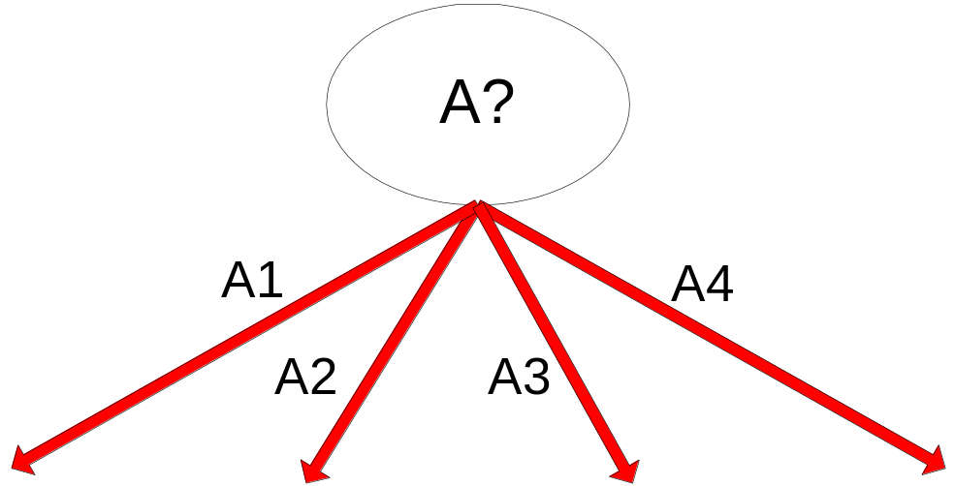
Example of Post-Pruning
Training Error (Before splitting) = 10/30
Pessimistic error = (10 + 0.5)/30 = 10.5/30
Training Error (After splitting) = 9/30
Pessimistic error (After splitting)
= (9 + 4 × 0.5)/30 = 11/30
PRUNE!
Class = Yes | 20
Class = No | 10
Error = 10/30
Class = Yes | 8
Class = No | 4
Class = Yes | 3
Class = No | 4
Class = Yes | 4
Class = No | 1
Class = Yes | 5
Class = No | 1

Slide 41
Model Evaluation
Metrics for Performance Evaluation
  How to evaluate the performance of a model?
Methods for Performance Evaluation
  How to obtain reliable estimates?
Methods for Model Comparison
  How to compare the relative performance among competing models?

Slide 42
Model Evaluation
Metrics for Performance Evaluation
  How to evaluate the performance of a model?
Methods for Performance Evaluation
  How to obtain reliable estimates?
Methods for Model Comparison
  How to compare the relative performance among competing models?

Slide 43
Metrics for Performance Evaluation
Focus on the predictive capability of a model
  Rather than how fast it takes to classify or build models, scalability, etc.
Confusion Matrix:
 | PREDICTED CLASS
ACTUAL CLASS |  | Class=Yes | Class=No
 | Class=Yes | a | b
 | Class=No | c | d
a: TP (true positive)
b: FN (false negative)
c: FP (false positive)
d: TN (true negative)

Slide 44
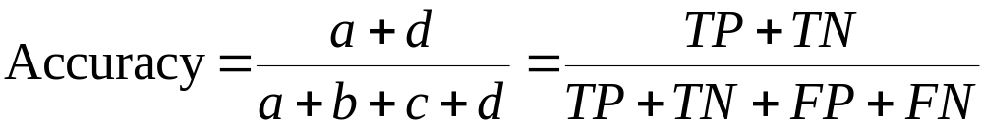
Metrics for Performance Evaluation…
Most widely-used metric:
 | PREDICTED CLASS
ACTUAL CLASS |  | Class=Yes | Class=No
 | Class=Yes | a (TP) | b (FN)
 | Class=No | c (FP) | d (TN)

Slide 45
Limitation of Accuracy
Consider a 2-class problem
  Number of Class 0 examples = 9990
  Number of Class 1 examples = 10
If model predicts everything to be class 0, accuracy is 9990/10000 = 99.9 %
  Accuracy is misleading because model does not detect any class 1 example

Slide 46
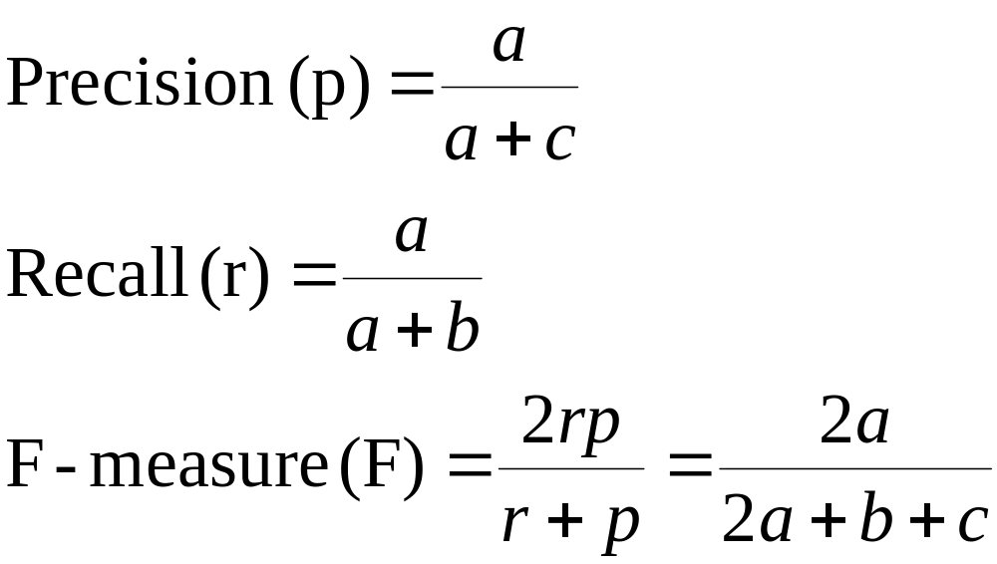
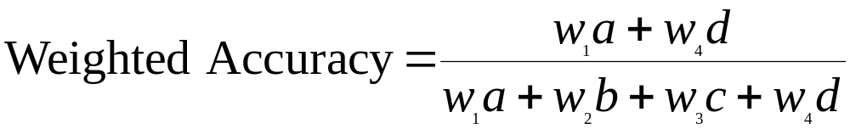
Cost-Sensitive Measures
Precision is biased towards C(Yes|Yes) & C(Yes|No)
Recall is biased towards C(Yes|Yes) & C(No|Yes)
F-measure is biased towards all except C(No|No)

Slide 47
Model Evaluation
Metrics for Performance Evaluation
  How to evaluate the performance of a model?
Methods for Performance Evaluation
  How to obtain reliable estimates?
Methods for Model Comparison
  How to compare the relative performance among competing models?

Slide 48
Methods for Performance Evaluation
How to obtain a reliable estimate of performance?
Performance of a model may depend on other factors besides the learning algorithm:
  Class distribution
  Cost of misclassification
  Size of training and test sets

Slide 49
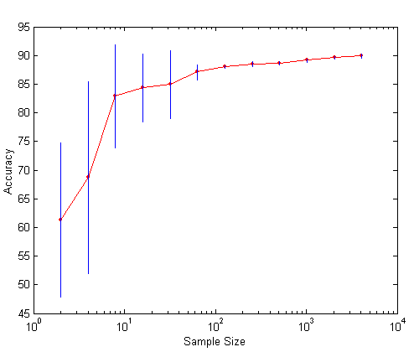
Learning Curve
Learning curve shows how accuracy changes with varying sample size
Requires a sampling schedule for creating learning curve:
Effect of small sample size:
  Bias in the estimate
  Variance of estimate

Slide 50
Methods of Estimation
Holdout
  2/3 for training and 1/3 for testing
Random subsampling
  Repeated holdout
Cross validation
  Partition data into k disjoint subsets
  k-fold: train on k-1 partitions, test on the remaining one
  Leave-one-out: k=n
Stratified sampling
  oversampling vs undersampling
Bootstrap
  Sampling with replacement
Training set
Test set
Training
Validation
Cross Validation

Slide 51
Model Evaluation
Metrics for Performance Evaluation
  How to evaluate the performance of a model?
Methods for Performance Evaluation
  How to obtain reliable estimates?
Methods for Model Comparison
  How to compare the relative performance among competing models?

Slide 52
ROC (Receiver Operating Characteristic)
Developed in 1950s for signal detection theory to analyze noisy signals
  Characterize the trade-off between positive hits and false alarms
ROC curve plots TP (on the y-axis) against FP (on the x-axis)
Performance of each classifier represented as a point on the ROC curve
  changing the threshold of algorithm, sample distribution or cost matrix changes the location of the point

Slide 53
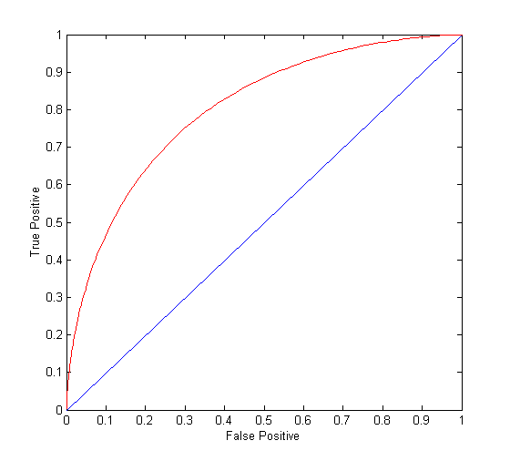
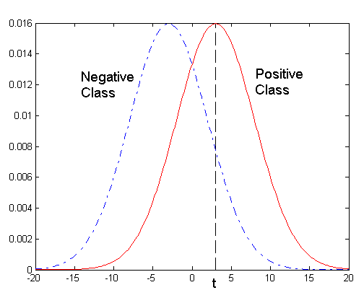
ROC Curve
- 1-dimensional data set containing 2 classes (positive and negative)
- any points located at x > t is classified as positive
At threshold t:
TP=0.5, FN=0.5, FP=0.12, FN=0.88

Slide 54
ROC Curve
(TP,FP):
(0,0): declare everything
to be negative class
(1,1): declare everything
to be positive class
(1,0): ideal
Diagonal line:
  Random guessing
  Below diagonal line:
    prediction is opposite of the true class

Slide 55
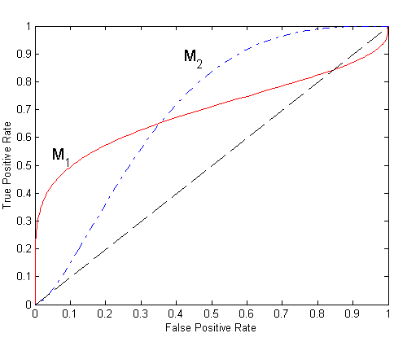
Using ROC for Model Comparison
No model consistently outperform the other
  M₁ is better for small FPR
  M₂ is better for large FPR
Area Under the ROC curve
  Ideal:
    Area = 1
  Random guess:
    Area = 0.5

Slide 56
Pros and Cons of Decision Tree
Advantages:
  Inexpensive to construct
  Extremely fast at classifying unknown records
  Easy to interpret for small-sized trees
  Accuracy is comparable to other classification techniques for many simple data sets
  Questions:
  High dimensional training data (many features)
  Noisy training data with missing values
  Stability on different training samples

